Slide 1

How SDNs will tame networks
Nick McKeown
Stanford University

Slide 2
As I was saying…
How big to make a backbone router buffer?
B
C

Slide 3
Buffer Size
100%
On-chip buffers
Smaller design
Lower power
Throughput
Window Size
Buffer
t
Number of packets
10Gb/s WAN
25,000
2,500,000

Slide 4
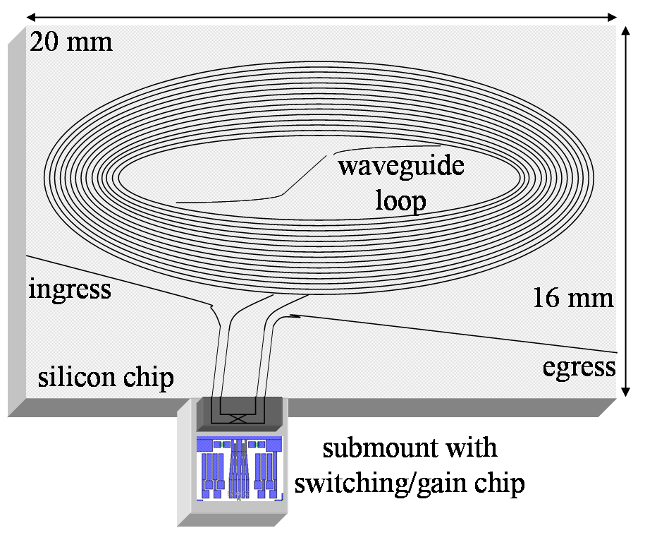
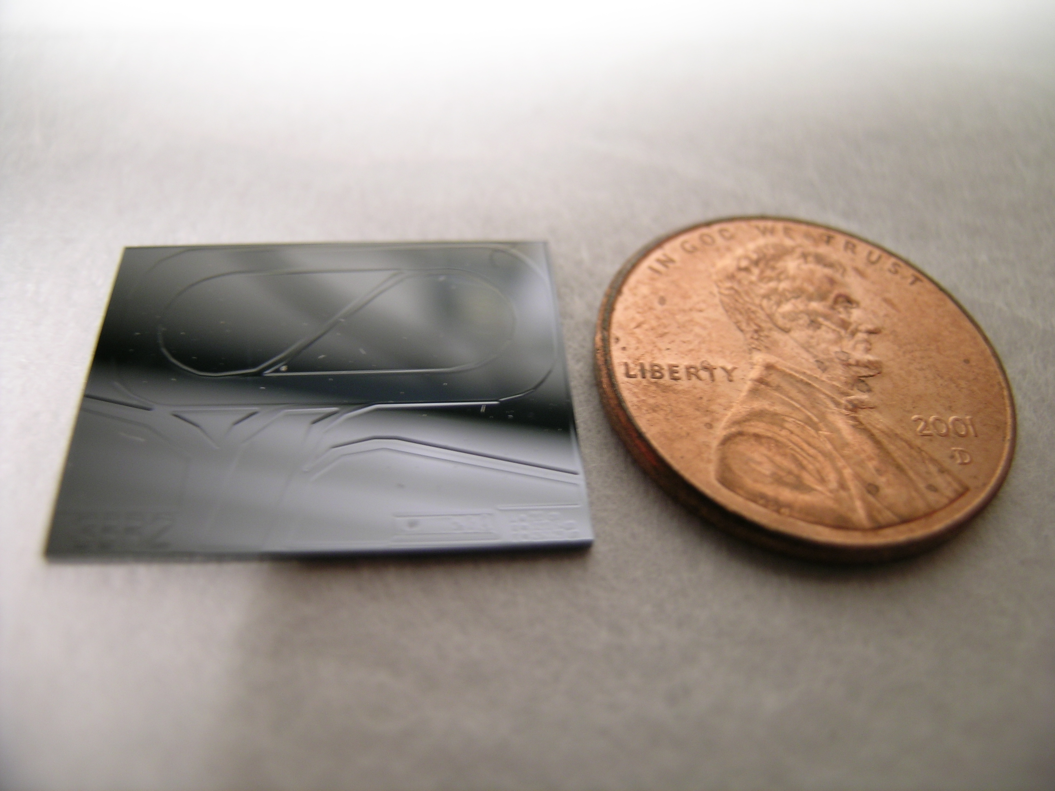
Buffer Size
100%
~ 90%
Integrated all-optical
buffer [UCSB 2008]
On-chip buffers
Smaller design
Lower power
Throughput
20 pkts
log(W)
Number of packets
10Gb/s WAN
~50
25,000
2,500,000

Slide 5
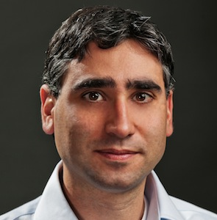
Software Defined Networks
Scott Shenker
Teemu Koponen
Guru Parulkar
+ many (brave) students
Martin Casado

Slide 6
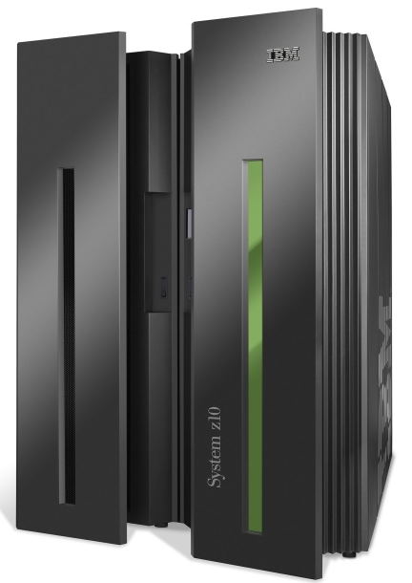
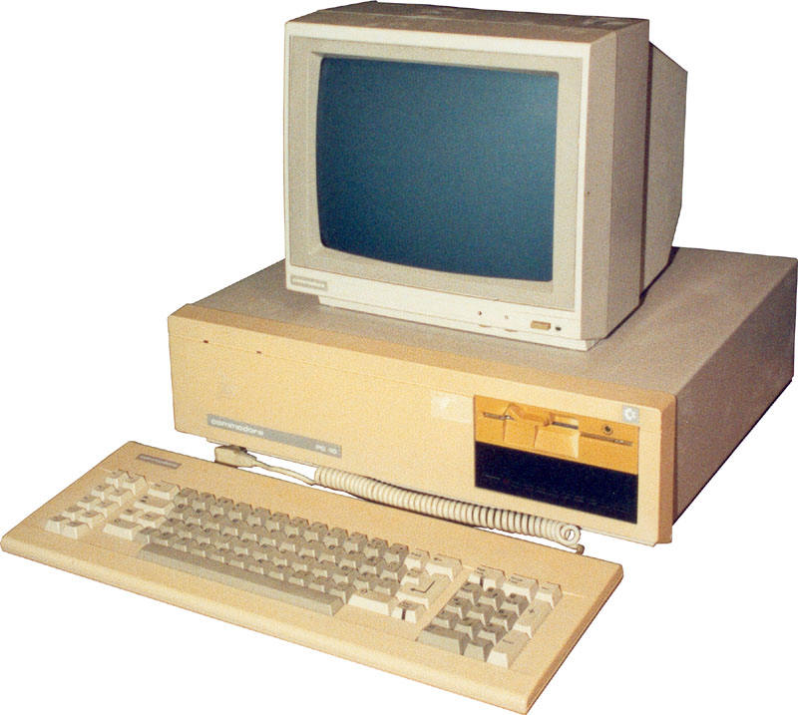
App
App
App
App
App
App
App
App
App
App
App
Specialized
Applications
Open Interface
Windows
(OS)
Linux
Mac
OS
Specialized
Operating
System
or
or
Open Interface
Specialized
Hardware
Microprocessor
Vertically integrated
Closed, proprietary
Slow innovation
Small industry
Horizontal
Open interfaces
Rapid innovation
Huge industry

Slide 7
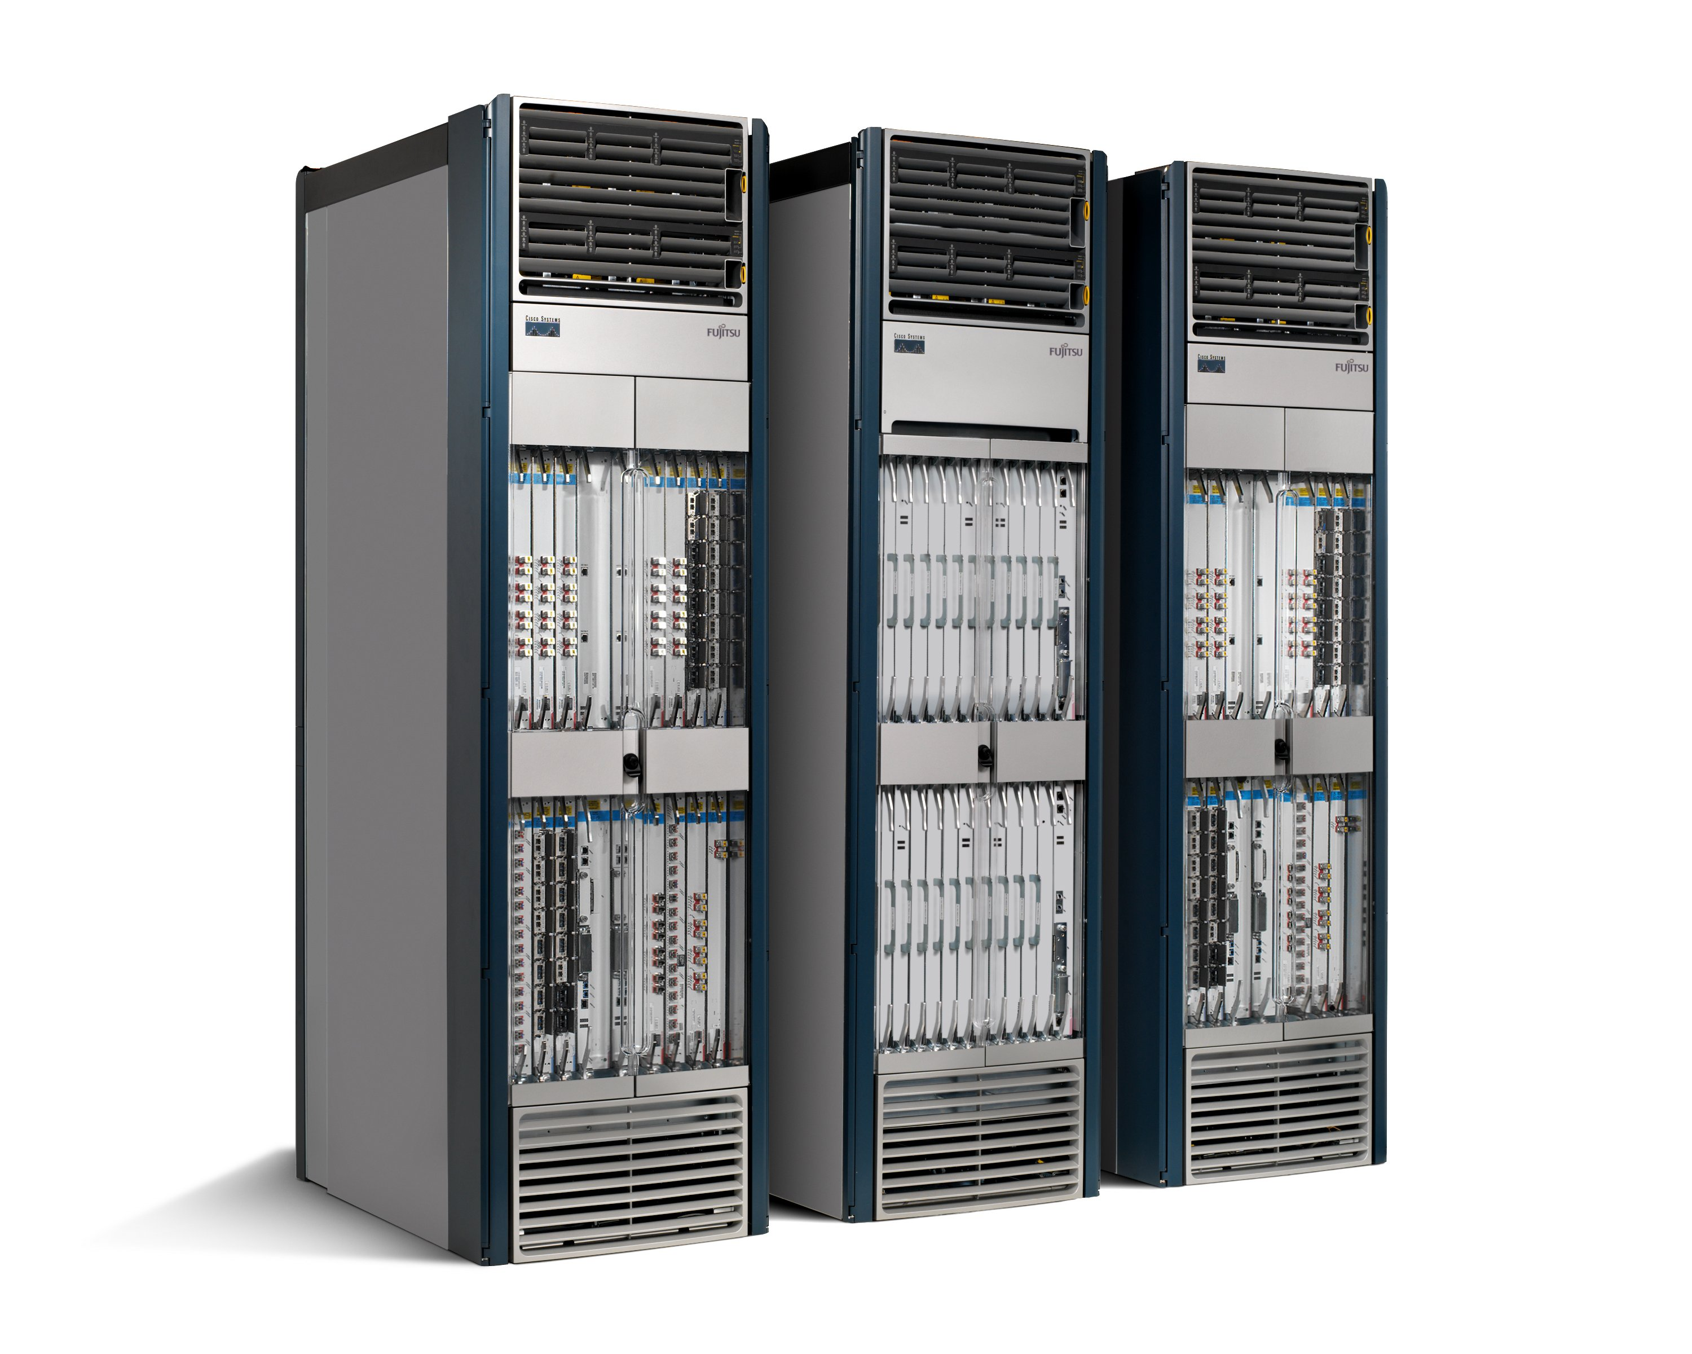
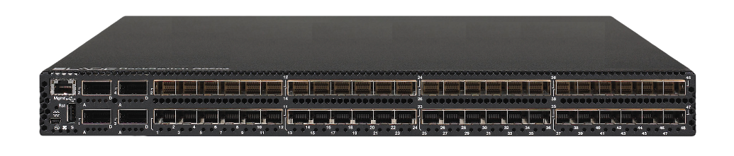
App
App
App
App
App
App
App
App
App
App
App
Specialized
Features
Open Interface
Control
Plane
Control
Plane
Control
Plane
or
or
Specialized
Control
Plane
Open Interface
Specialized
Hardware
Merchant
Switching Chips
Vertically integrated
Closed, proprietary
Slow innovation
Horizontal
Open interfaces
Rapid innovation

Slide 8
Where SDN will be deployed
Multi-tenant “virtualized” data centers
  Public and private clouds
WANs
  Google WAN
  Eventually, public WANs
Enterprise networks
  Greater control, fewer middleboxes

Slide 9
Where SDN will be deployed (2)
4. Home networks
  Outsourced management
5. Cellular Networks
  Separation of service from physical infrastructure
6. Research and Education Networks
  National backbones
  College campus networks

Slide 10
Getting Started
OpenFlow Tutorial
  search: “OpenFlow Tutorial”
Mininet
  Network emulator
  Designed for emulating SDN networks
  Easy to use
  High performance (100 nodes on a laptop)
  search: “Mininet”

Slide 11
Tool & Deployment Support
Open Networking Lab (ON.Lab)
  Independent non-profit lab
  Open source tools
  Help with deployments
  Based in Palo Alto
  Hiring…

Slide 12
OpenFlow Switches?
Software switch
  Open vSwitch (openvswitch.org)
  Now part of Linux distribution
Hardware switches
  Announcements from several vendors
  HP, Brocade, NEC, …
  (You could ask Google for one of theirs ☺)
Switch ASICs
  Current ASICs work, but not optimized for OpenFlow
  Expect some OpenFlow-optimized ASICs in 1-2 years

Slide 13
An example: What’s possible in silicon
Stanford/TI Labs collaboration
64 x 10Gb/s
Multiple table support (>12 flexible stages)
64k TCAM entries (wide) for wildcards
128k hash table entries (wide) for exact matches
>1k queues per port
All OpenFlow counters
On-chip ARM CPU
Generic ALU-based action engine
With permission from Texas Instruments

Slide 14
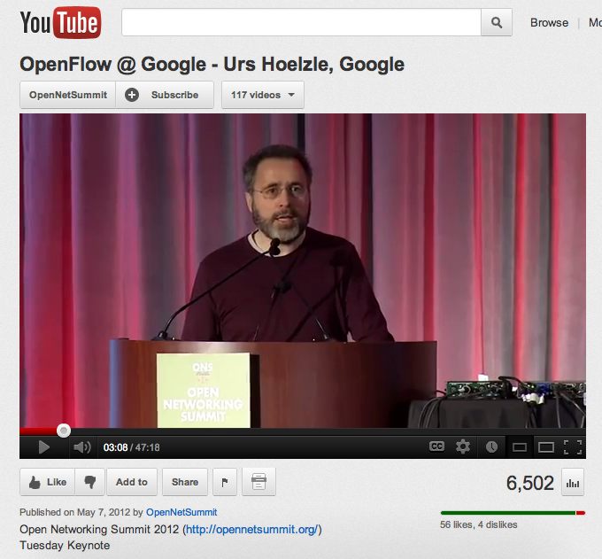
If you are in any doubt about whether OpenFlow/SDN will be deployed in the WAN:
Urs Hoelzle (Google) at Open Networking Summit 2012

Slide 15
Making Networks Work
New Research Area
An intellectual framework for verifying, troubleshooting and debugging SDNs

Slide 16
With SDN we can:
  Formally verify that our networks are behaving correctly.
  Identify bugs, then systematically track down their root cause.

Slide 17
Ensuring correctness [Frenetic][HFT][Netcore]
Nate Foster, Andrew Ferguson, Mike Freedman, Jen Rexford, Rob Harrison, Dave Walker, ++
Software Fault Localization [W3]
Scott Shenker, Colin Scott, Kyriakos Zarifis, Andreas Wundsam.
Checking behavior [NICE]
Marco Canini, Daniele Venzano, Peter Peresini, Dejan Kostic, Jen Rexford.
Checking Invariants [VeriFlow]
Ahmed Khurshid, Wenxuan Zhou, Matthew Caesar, P. Brighten Godfrey
Consistent updates
Mark Reitblatt, Rick McGeer, ++
Troubleshooting [OFRewind]
Andreas Wundsam, Dan Levin, Srini Seetharaman, Anja Feldman
…

Slide 18
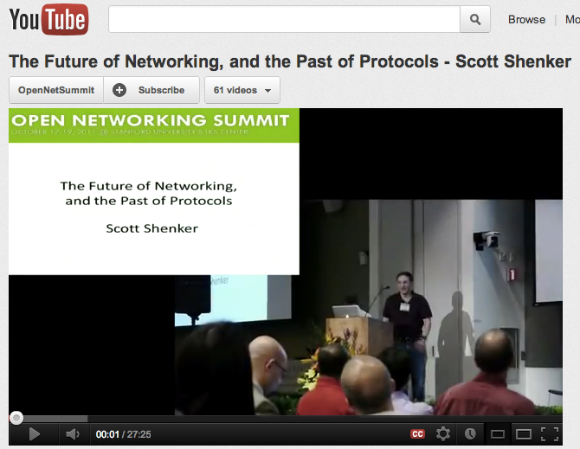
Scott Shenker at 1st ONS in 2011
“The Future of Networking and the Past of Protocols”

Slide 19
Software Defined Network (SDN)
Control
Programs
Control
Programs
Control
Programs
Abstract Network View
Network Virtualization
Global Network View
Network OS
Packet
Forwarding
Packet
Forwarding
Packet
Forwarding
Packet
Forwarding
Packet
Forwarding

Slide 20
Software Defined Network (SDN)
firewall.c
…
if( pkt->tcp->dport == 22)
dropPacket(pkt);
…
Control
Programs
Control
Programs
Control
Programs
Abstract Network View
Network Virtualization
Global Network View
Network OS
<Match, Action>
<Match, Action>
<Match, Action>
<Match, Action>
<Match, Action>
…
…
<Match, Action>
<Match, Action>
<Match, Action>
<Match, Action>
<Match, Action>
…
…
Packet
Forwarding
<Match, Action>
<Match, Action>
<Match, Action>
<Match, Action>
<Match, Action>
…
…
<Match, Action>
<Match, Action>
<Match, Action>
<Match, Action>
<Match, Action>
…
…
Packet
Forwarding
<Match, Action>
<Match, Action>
<Match, Action>
<Match, Action>
<Match, Action>
…
…
Packet
Forwarding
Packet
Forwarding
Packet
Forwarding

Slide 21
How do other industries do it?

Slide 22
Making ASICs Work
Specification
$10B tool business
supports a
$250B chip industry
Functional Description (RTL)
Testbench & Vectors
Functional Verification
Logical Synthesis
100s of Books
>10,000 Papers
10s of Classes
Static Timing
Place & Route
Design Rule Checking (DRC)
Layout vs Schematic (LVS)
Layout Parasitic Extraction (LPE)
Manufacture
& Validate

Slide 23
Making Software Work
Specification
$10B tool business
supports a
$300B S/W industry
Functional Description (Code)
Testbench
Static Code Analysis
Invariant
Checker
Model Checking
100s of Books
>100,000 Papers
10s of Classes
Run-time Checker
Interactive Debugger

Slide 24
Making Networks Work (Today)
traceroute, ping, tcpdump, SNMP, Netflow
…. er, that’s about it.

Slide 25
Why debugging networks is hard
Complex interaction
  Between multiple protocols on a switch/router.
  Between state on different switches/routers.
Multiple uncoordinated writers of state.
Operators can’t…
  Observe all state.
  Control all state.

Slide 26
Networks are kept working by
“Masters of Complexity”
A handful of books
Almost no papers
No classes

Slide 27
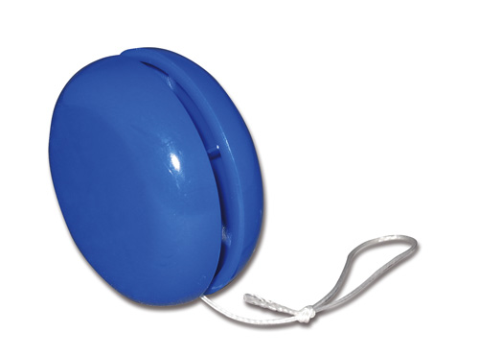
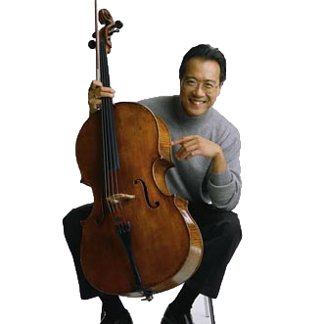
Philosophy of Making Networks Work
YoYo
“You’re On Your Own”
Yo-Yo Ma
“You’re On Your Own, Mate”

Slide 28
With SDN we can:
  Formally verify that our networks are behaving correctly.
  Identify bugs, then systematically track down their root cause.

Slide 29
Software Defined Network (SDN)
2
firewall.c
…
if( pkt->tcp->dport == 22)
dropPacket(pkt);
…
Control
Programs
Control
Programs
Control
Programs
Abstract Network View
<Match, Action>
<Match, Action>
<Match, Action>
<Match, Action>
<Match, Action>
…
…
Network Virtualization
3
1
Global Network View
Network OS
Packet
Forwarding
Packet
Forwarding
4
Packet
Forwarding
Packet
Forwarding
Packet
Forwarding

Slide 30
Three of our projects
Static Checking [HSA]
“Independently checking correctness”
Automatic Testing [ATPG]
“Is the datapath behaving correctly?”
Interactive Debugging [ndb]
“Finding bugs, and their root cause,
in an operational network”

Slide 31

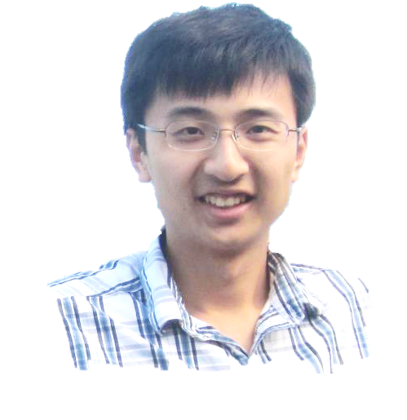
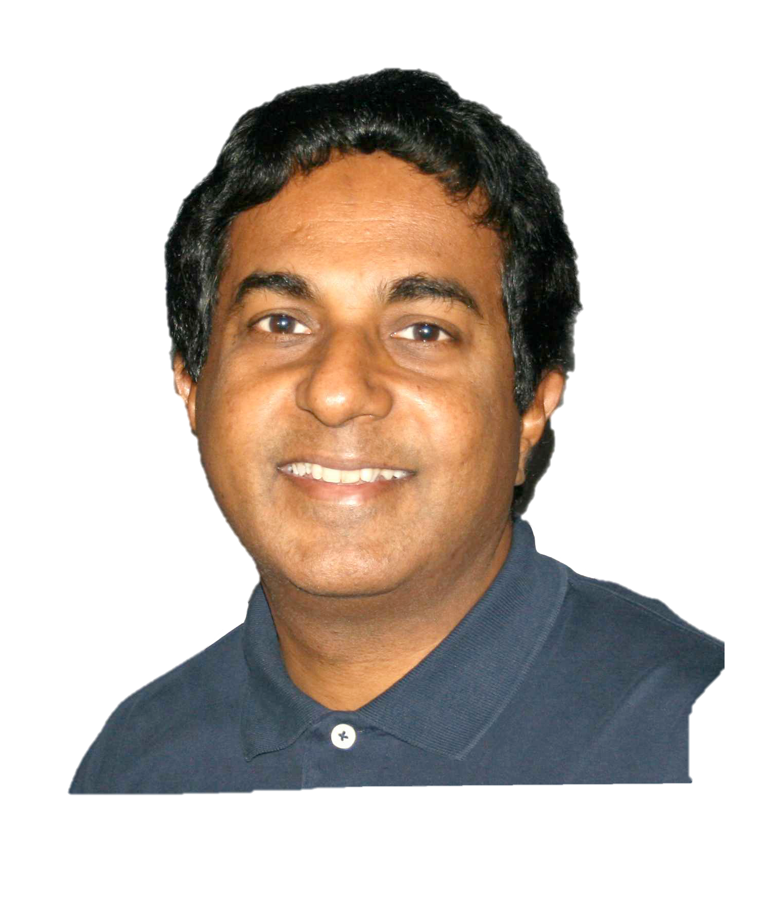
1. Static checking
Independently checking correctness
Peyman
Kazemian
Hongyi
‘James’
Zeng
George
Varghese
(UCSD)

Slide 32
Motivations
In today’s networks, simple questions are hard to answer:
  Can host A talk to host B?
  What are all the packet headers from A that can reach B?
  Are there any loops in the network?
  Is Group X provably isolated from Group Y?
  What happens if I remove a line in the config file?

Slide 33
Software Defined Network (SDN)
Policy
Control
Programs
Control
Programs
Control
Programs
“A can talk to B”
“Guests can’t reach PatientRecords”
Abstract Network View
Network Virtualization
Global Network View
Static Checker
Network OS
<Match, Action>
<Match, Action>
<Match, Action>
<Match, Action>
<Match, Action>
…
…
<Match, Action>
<Match, Action>
<Match, Action>
<Match, Action>
<Match, Action>
…
…
<Match, Action>
<Match, Action>
<Match, Action>
<Match, Action>
<Match, Action>
…
…
<Match, Action>
<Match, Action>
<Match, Action>
<Match, Action>
<Match, Action>
…
…
<Match, Action>
<Match, Action>
<Match, Action>
<Match, Action>
<Match, Action>
…
…
<Match, Action>
<Match, Action>
<Match, Action>
<Match, Action>
<Match, Action>
…
…
Packet
Forwarding
<Match, Action>
<Match, Action>
<Match, Action>
<Match, Action>
<Match, Action>
…
…
<Match, Action>
<Match, Action>
<Match, Action>
<Match, Action>
<Match, Action>
…
…
Packet
Forwarding
<Match, Action>
<Match, Action>
<Match, Action>
<Match, Action>
<Match, Action>
…
…
<Match, Action>
<Match, Action>
<Match, Action>
<Match, Action>
<Match, Action>
…
…
<Match, Action>
<Match, Action>
<Match, Action>
<Match, Action>
<Match, Action>
…
…
<Match, Action>
<Match, Action>
<Match, Action>
<Match, Action>
<Match, Action>
…
…
Packet
Forwarding
Packet
Forwarding
<Match, Action>
<Match, Action>
<Match, Action>
<Match, Action>
<Match, Action>
…
…
<Match, Action>
<Match, Action>
<Match, Action>
<Match, Action>
<Match, Action>
…
…
Packet
Forwarding

Slide 34
How it works
Header Space Analysis

Slide 35
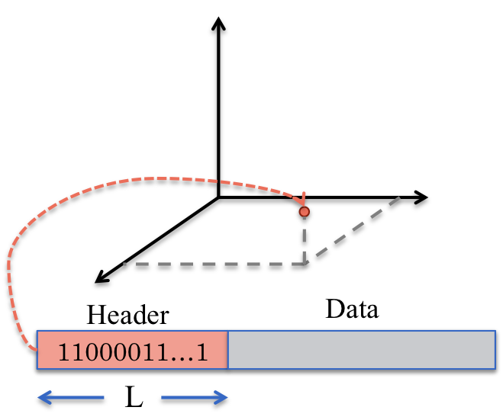
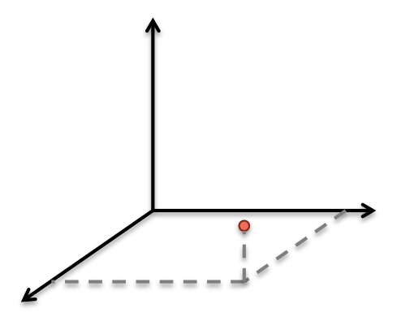
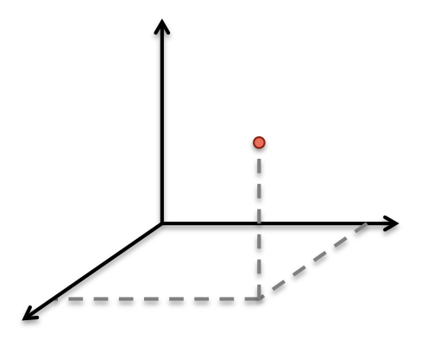
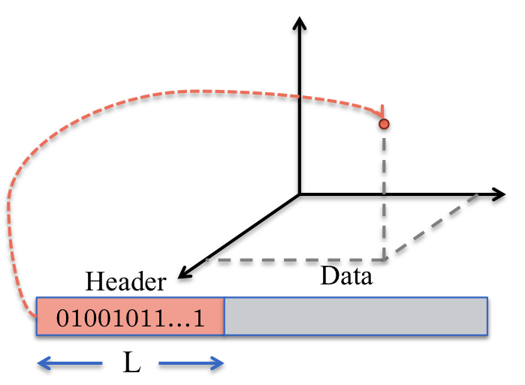


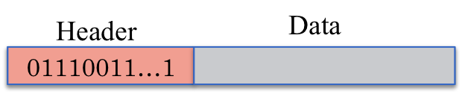
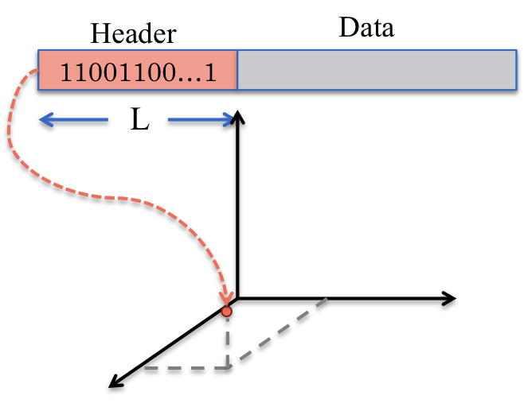
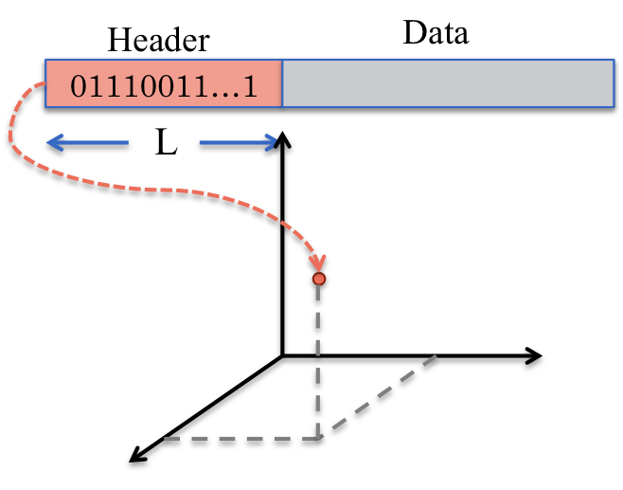
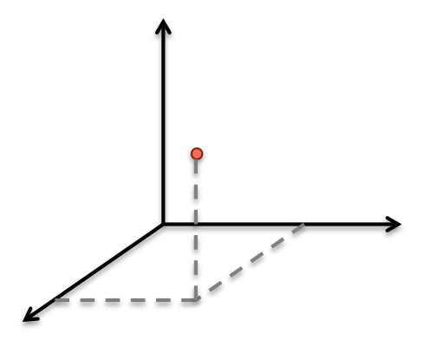
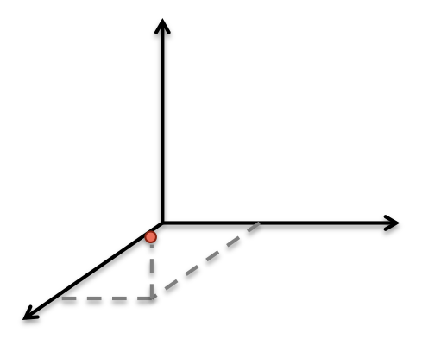
Header Space Analysis
2
3
A
1
B
4
A
1
2
Port ID
3
4
B

Slide 36
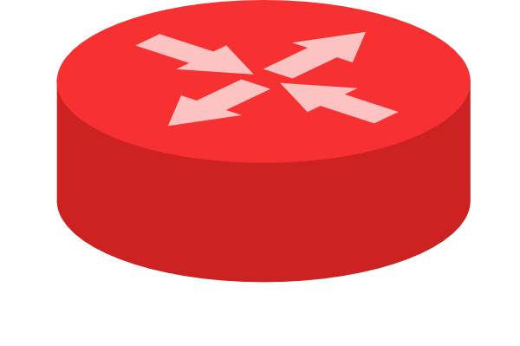
Header Space Analysis
2
3
A
1
B
4
1
2
3
4
Port ID

Slide 37
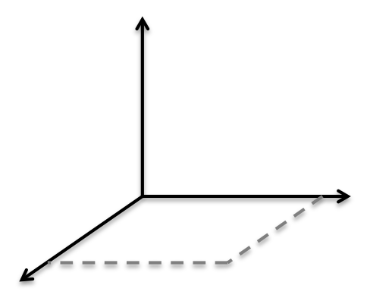
Can A talk to B?
2
3
A
1
B
4
1
2
3
4
Port ID
Notes:
----- Meeting Notes (4/17/12 18:54) -----
Now let's ask the question of whether A can talk to B.

Slide 38
All packets from A that can reach B
A
B

Slide 39
Header Space Analysis
[Kazemian NSDI ‘12]
Consequences
  Abstract forwarding model; protocol independent
  Finds all packets from A that can reach B
  Find loops, regardless of protocol or layer
  Can prove that two groups are isolated
Can verify if network adheres to policy

Slide 40
HSA as a “foundation”
HAS enables many tools and methods
  Independent static checking
  In-line in-controller invariance checking
  Dynamic testing: Automatic test packet generation
  Dynamic testing: Automatic performance monitoring
Analogy to Boolean algebra for logic design

Slide 41
Software
Hassel tool
  Reads Cisco IOS Configuration
  Checks reachability, loops and isolation
  C: 60ms for Stanford Backbone
  Python: 10 mins for Stanford Backbone
Code
  http://bitbucket.org/peymank/hassel-public

Slide 42
Three of our projects
Static Checking [HSA]
“Independently checking correctness”
Automatic Testing [ATPG]
“Is the datapath behaving correctly?”
Interactive Debugging [ndb]
“Finding bugs, and their root cause,
in an operational network”

Slide 43

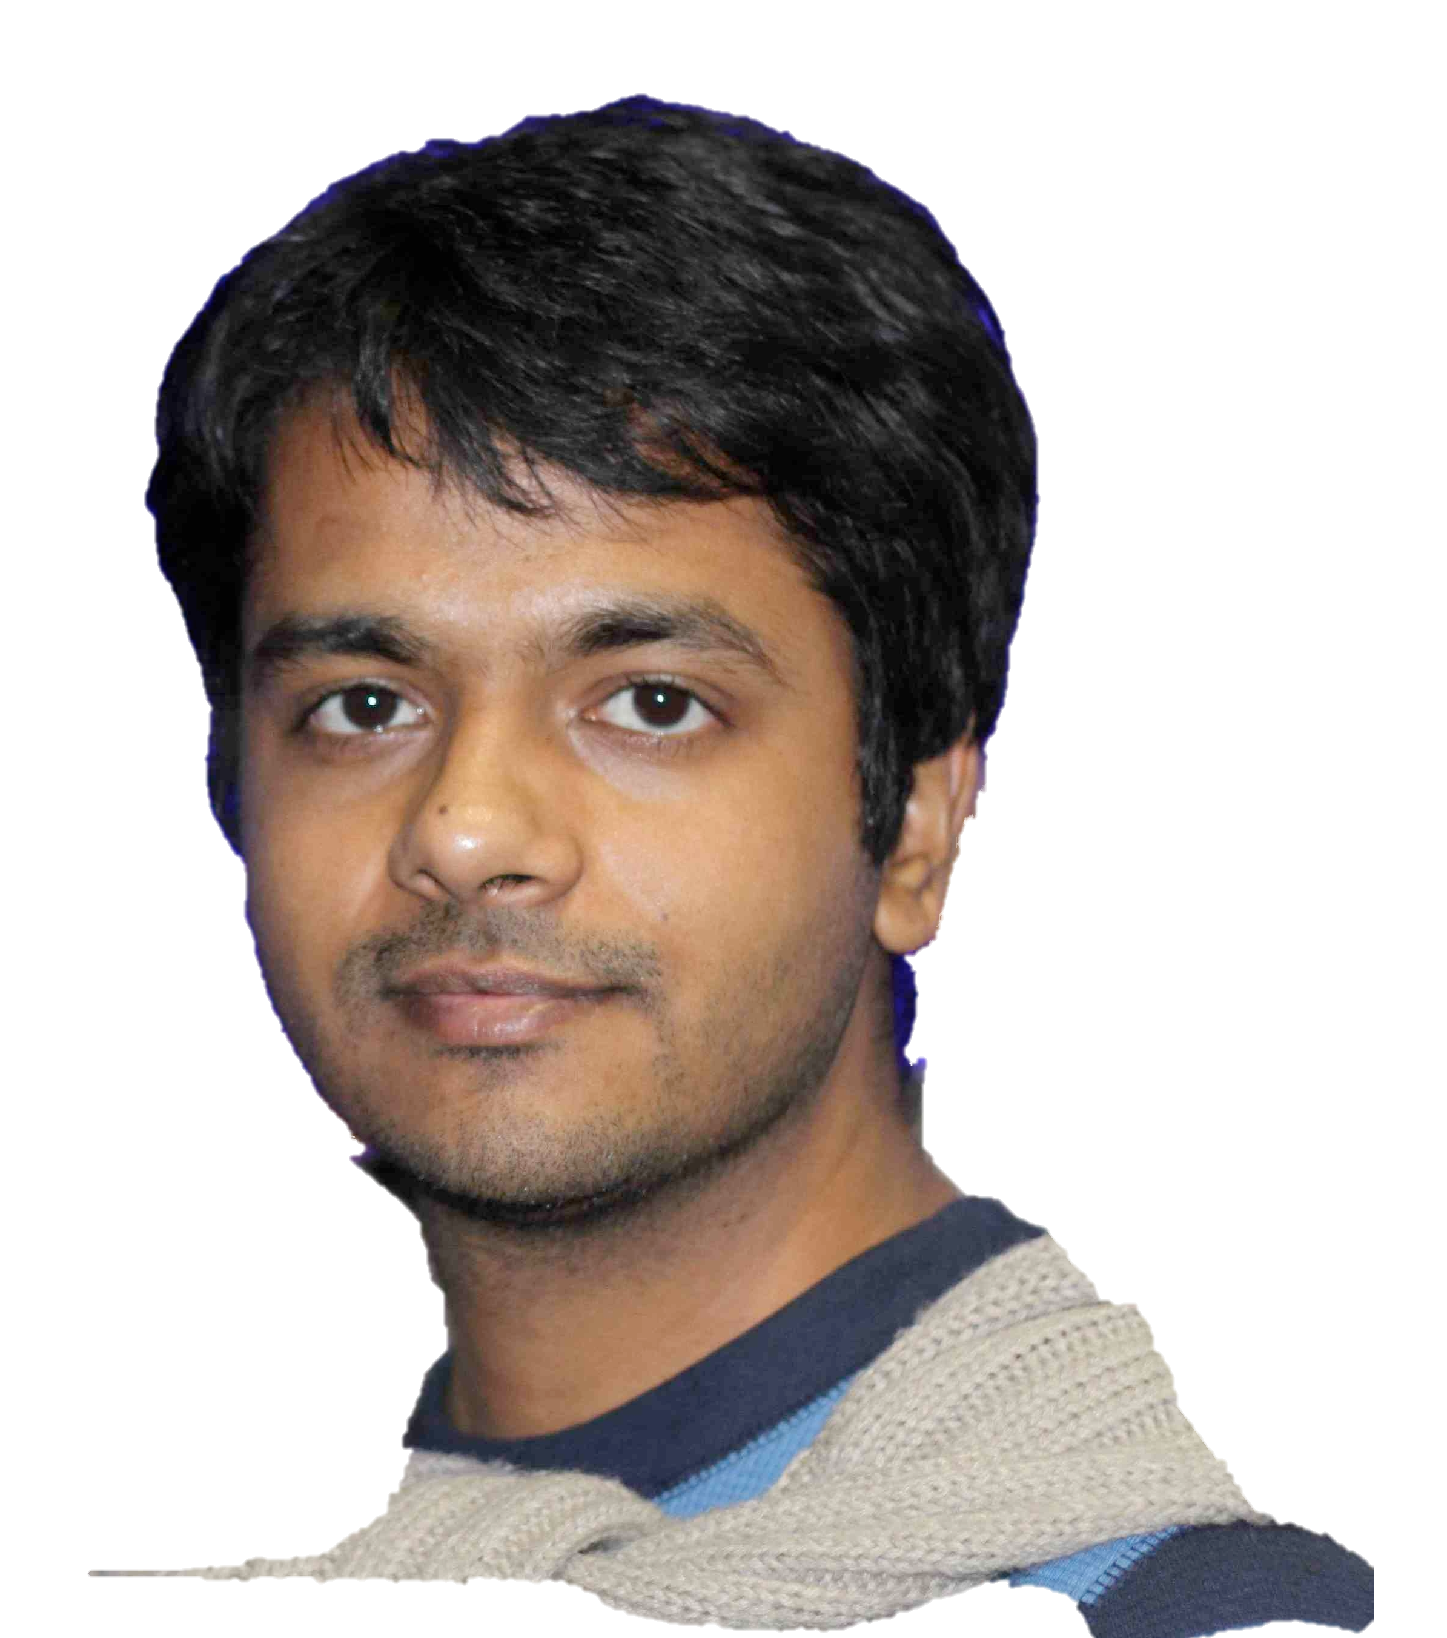

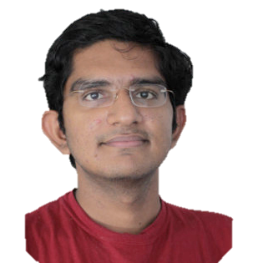
3. Interactive Debugging
Finding bugs, and their root cause, in an operational network
Nikhil
Handigol
Brandon
Heller
Vimal
Jeyakumar
David
Mazières

Slide 44
Backtrace: Software Programming
Function A():
u = B(v)
Breakpoint
  “u == error”
Backtrace
  File “A”, line 10, Function A()
  File “B”, line 43, Function B()
  File “C”, line 21, Function C()
Function B():
w = C(x)
Function C():
y = error

Slide 45
Interactive Debugging with ndb
Problem
  When an operational network misbehaves,
  it is very hard to find the root cause.
Goal
  Allow users to define a Network Breakpoint.
  Capture and reconstruct the sequence of events leading to the breakpoint.

Slide 46
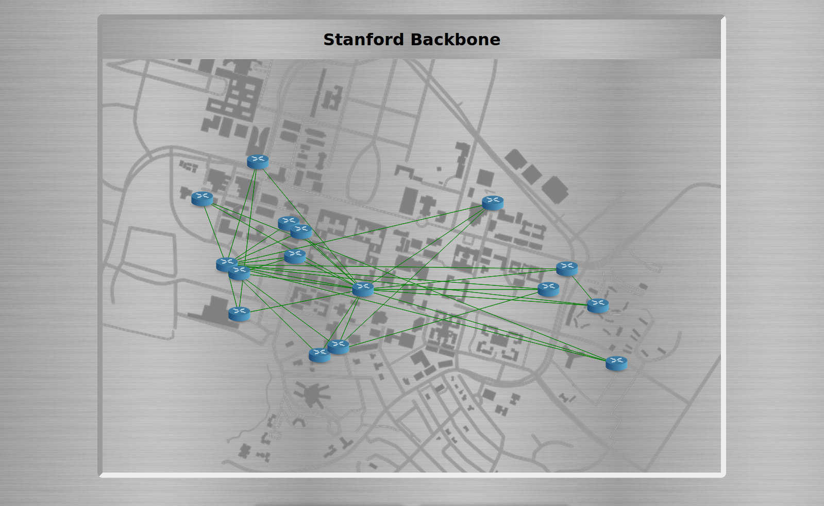

Network Debugger
B
S
A
Breakpoint
Switch = S
IP src = A, IP dst = B
TCP Port = 22
Collector

Slide 47

Network Debugger
<Match, Action>
<Match, Action>
<Match, Action>
<Match, Action>
<Match, Action>
…
…
<Match, Action>
<Match, Action>
<Match, Action>
<Match, Action>
<Match, Action>
…
…
<Match, Action>
<Match, Action>
<Match, Action>
<Match, Action>
<Match, Action>
…
…
<Match, Action>
<Match, Action>
<Match, Action>
<Match, Action>
<Match, Action>
…
…
Collector

Slide 48
Control
Programs
Control
Programs
Control
Programs
Network Virtualization
Network OS
Flow Table State Recorder
B
<Packet ID, Version>
A
<Flow Table State, Version>
Collector

Slide 49
Control
Programs
Control
Programs
Control
Programs
Network Virtualization
Network OS
<Match, Action>
<Match, Action>
<Port == 22, Drop>
<Match, Action>
<Match, Action>
<Match, Action>
S
Breakpoint
Switch = S
IP src = A, IP dst = B
TCP Port = 22
Collector

Slide 50
Who benefits
Network developers
  Programmers debugging control programs
Network operators
  Find policy error
  Send error report to switch vendor
  Send error report to control program vendor

Slide 51
Status
First working prototype of ndb
  Works without change to OpenFlow
Performance on Stanford backbone
  Collector could be just one server
Collector

Slide 52
firewall.c
…
if( pkt->tcp->dport == 22)
dropPacket(pkt);
…
Control
Programs
Control
Programs
Control
Programs
Network Virtualization
Network OS
<Match, Action>
<Match, Action>
<Port == 22, Drop>
<Match, Action>
<Match, Action>
<Match, Action>
S
Breakpoint
Switch = S
IP src = A, IP dst = B
TCP Port = 22
Collector

Slide 53
Software Defined Network (SDN)
2
firewall.c
…
if( pkt->tcp->dport == 22)
dropPacket(pkt);
…
Control
Programs
Control
Programs
Control
Programs
Abstract Network View
<Match, Action>
<Match, Action>
<Match, Action>
<Match, Action>
<Match, Action>
…
…
Network Virtualization
3
1
Global Network View
Network OS
Packet
Forwarding
Packet
Forwarding
4
Packet
Forwarding
Packet
Forwarding
Packet
Forwarding

Slide 54
With SDN we will:
  Formally verify that our networks are behaving correctly.
  Identify bugs, then systematically track down their root cause.

Slide 55
Software Defined Networks
Allows a stronger intellectual foundation to networking
Allows us to define the right abstractions
Will allow us to transfer technology much faster, in both directions
Is already closing the gap with industry

Slide 56
The End

